Slide 1
Multithreading

Slide 2
Multithreading
A multithreaded program contains two or more parts that can run concurrently. Each part of such a program is called a thread, and each thread defines a separate path of execution.
Multithreading enables you to write very efficient programs that make maximum use of the CPU, because idle time can be kept to a minimum.
The Java run-time system depends on threads for many things, and all the class libraries are designed with multithreading

Slide 3
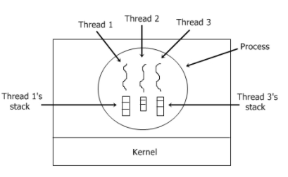
Thread model

Slide 4
Java Thread
Thread states – ready, running, suspended, resumed, blocked.
Thread priorities - A thread can voluntarily relinquish control or A thread can be preempted by a higher-priority thread.
Synchronization - interprocess synchronization: monitor
Messaging - communicate with each other

Slide 5
Multithreading
Java’s multithreading system is built upon the Thread class, its methods, and its companion interface, Runnable.
getName - Obtain a thread’s name.
getPriority - Obtain a thread’s priority.
isAlive - Determine if a thread is still running.
join - Wait for a thread to terminate.
run - Entry point for the thread.
sleep - Suspend a thread for a period of time.
Start - Start a thread by calling its run method.

Slide 6
Creating a Thread
You can implement the Runnable interface.
You can extend the Thread class, itself.
Refer CreateThread.pdf
Not only may the results vary from machine to machine, but running the same program multiple times on the same machine may produce different results. Never assume one thread will do something before another thread does, unless you've used synchronization to force a specific ordering of execution.

Slide 7
Multiple Threads
Program can spawn as many threads as it needs
Refer MultipleThread.pdf

Slide 8
isAlive and join
The isAlive( ) method returns true if the thread upon which it is called is still running. It returns false otherwise.
The join method allows one thread to wait for the completion of another.
t.join();
If t is a Thread object whose thread is currently executing, causes the current thread to pause execution until t's thread terminates.

Slide 9
Join ( )
Join method from Thread class is an important method and used to impose order on execution of multiple Threads.
“You have three threads T1, T2, and T3, How do you ensure that they finish in order T1, T2, T3 ?.
By calling T1.join() from T2 and T2.join() from T3. In this case thread, T1 will finish first, followed by T2 and T3.
The primary use of Thread.join() is to wait for another thread and start execution once that Thread has completed execution or died.
Join is also a blocking method, which blocks until the thread on which join has called die or specified waiting time is over.
Refer SimpleJoin.pdf

Slide 10
Thread Priority
MIN_PRIORITY - 1
MAX_PRIORITY - 10
NORM_PRIORITY – 5
Refer ThreadPri.pdf
volatile Java variable means: The value of this variable will never be cached thread-locally: all reads and writes will go straight to "main memory"; Access to the variable acts as though it is enclosed in a synchronized block,

